Slide 1
Follow Up to Homework Assignment for Week 5
Comments:
-Discussion on Production Deployment (and accelerator question #2, Dataset 4) was excellent.
-Good progress and strong demonstration of skills on accelerator assignment.
-Evidence of mastery using Rapidminer and Forecasting
-I am continuing to press everyone on variable selection—critical point (e.g. in real life for a problem like question #1 you could/should consider base freight if pricing was a consideration in carrier selection. Most likely an omitted variable---such as shipping weight, dimensions, ship to location would have helped a weak dataset. Spurious correlation with inventory most likely. Ask five whys.
-Variation in computer output from my answers is usually based upon variable selection and/or parameter settings—no points taken off for that.
-Perfectly performing models need a justification as to how this could be occurring and why it makes sense to you to use. Beware of AUC’s =1.0.
-Production models will not have all historical variables (e.g. can’t have late Flag or days late or premiums due to lateness) but can have routings, material numbers, work centers and customer numbers. Non-manufacturing situations will have different but analogous types of fields.

Slide 2
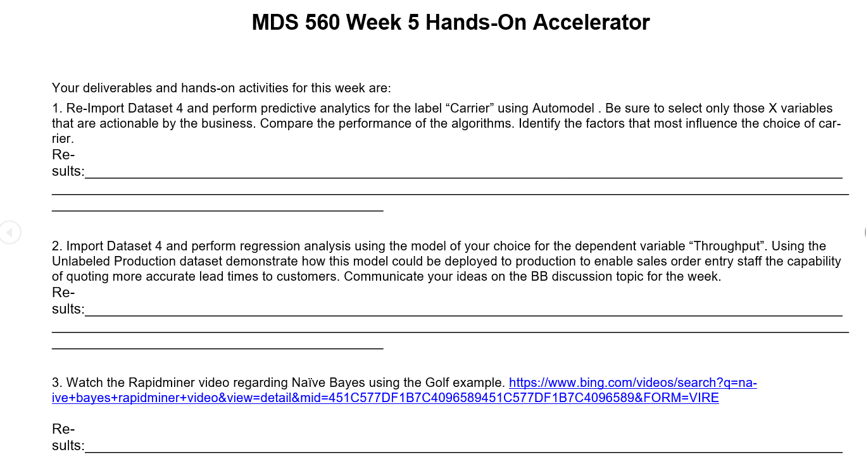

Slide 3
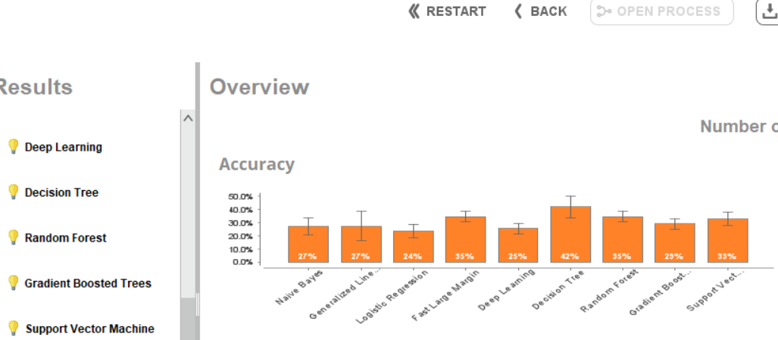
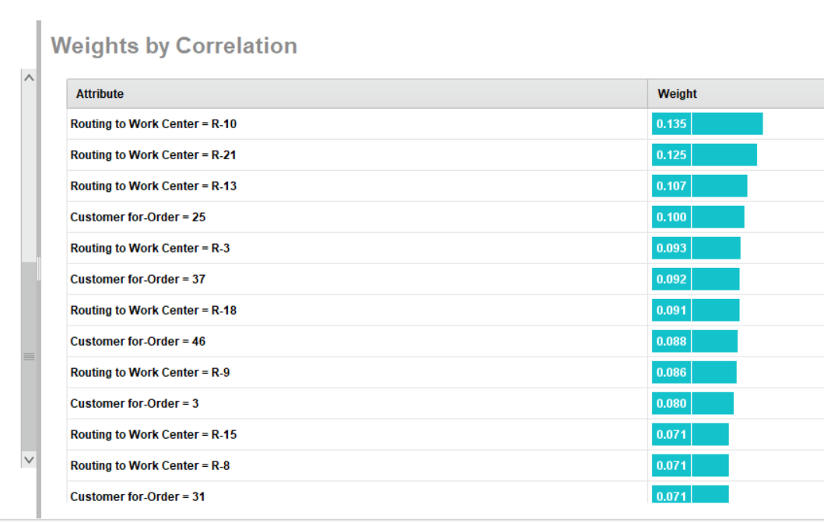
Predicting Carrier Using Automodel
Model performance improves if base freight is added, but should it be?
Most likely an omitted variable—shipping weight, ship to location, etc
Illustrates why organizations invest in new IT systems.

Slide 4
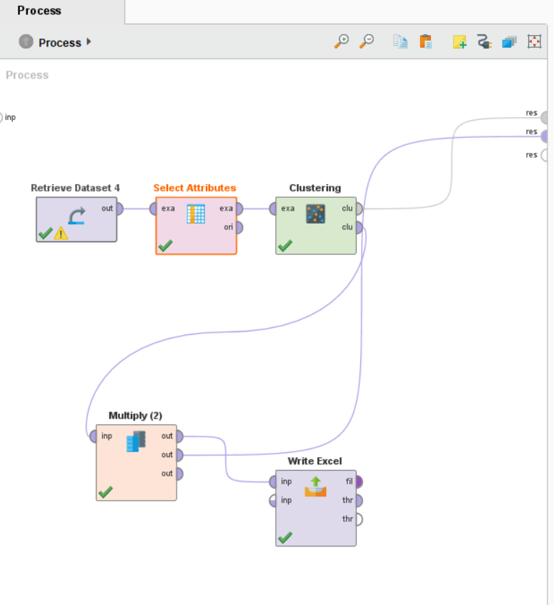
Clustering is often a very useful step for segmentation of the target population.

Slide 5
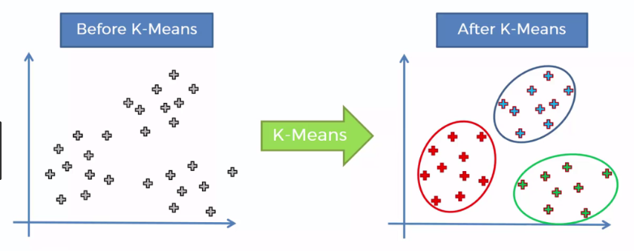

Slide 6
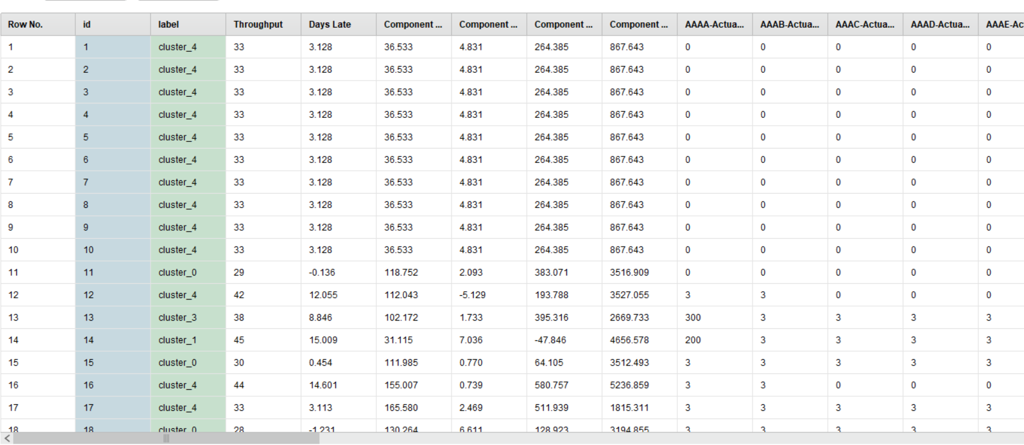

Slide 7
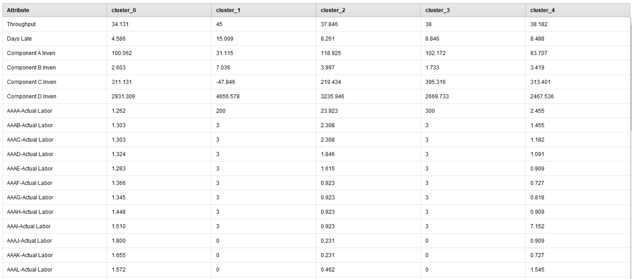

Slide 8
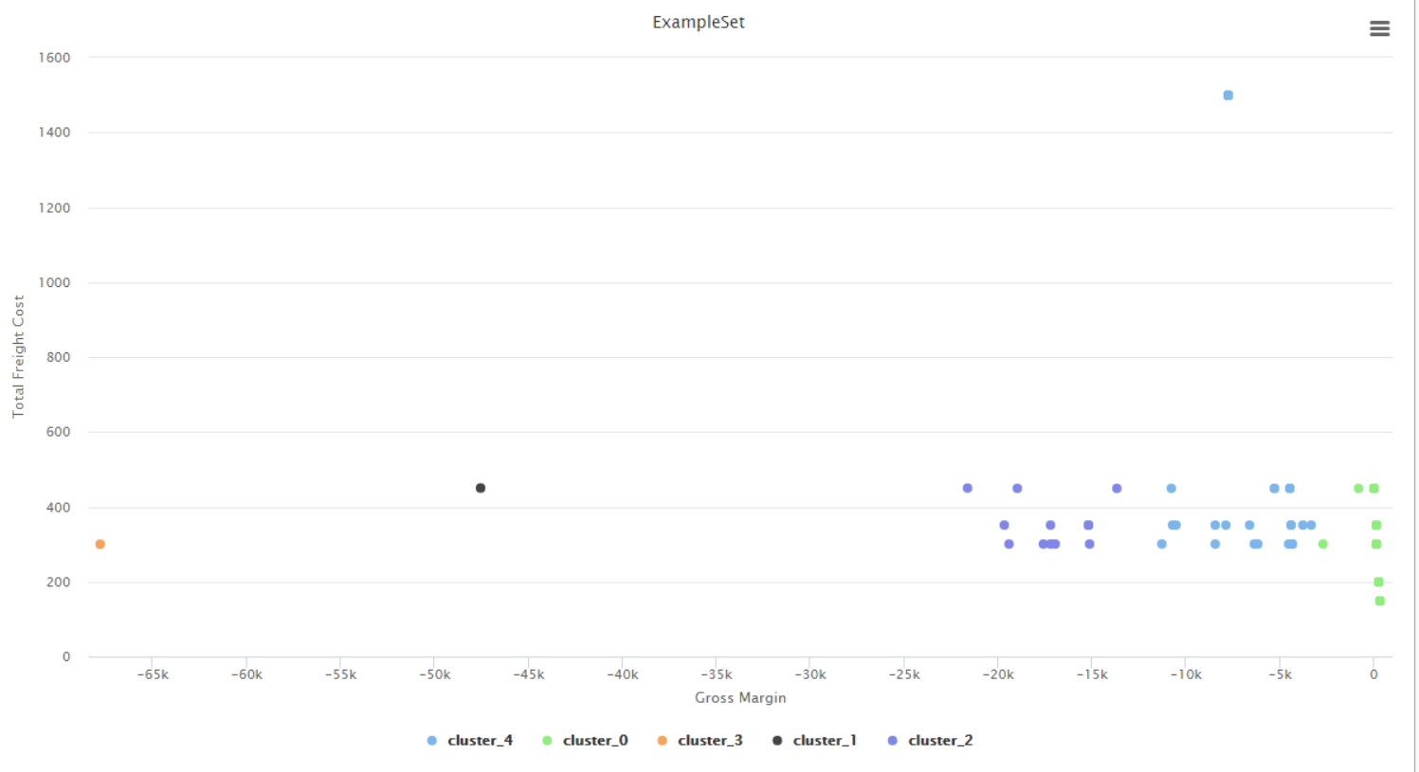
By Performing Segmentation Using Clustering We Might Try To Create Decision Rules For Carrier Selection

Slide 9
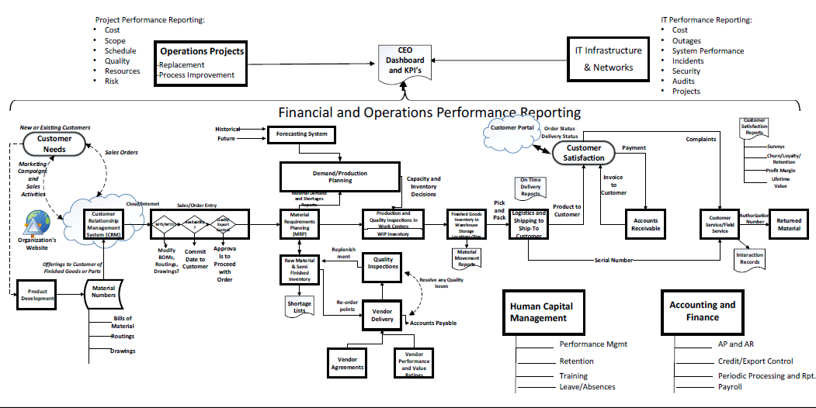
Deploy to Production a Tool For Providing Accurate Lead Times to Customers Using Throughput as Dependent Variable

Slide 10
Peirce’s Trichotomy of the Scientific Method
As Self Correcting Cycles Leading to the “Truth”
Multiple
Hypotheses
Abductive
Reasoning
Begin Next Cycle with Convergence on “Truth”
What are Testable Conclusions About Other Phenomenon That Must Be Reached For Each Hypothesis if True?
Controlled Experiments Based Upon Samples From a Population
Explanatory
Hypotheses
Experience
What Must
Happen If True?
Deductive
Reasoning
Begin Research
Assess Results of Application and Adjust Hypotheses
A Question
Sufficient Accuracy Reached to Take Action
Elimination
of False Hypotheses
(retroduction)
Test Predictive
Models
Execute Actions
Inductive
Reasoning
Assess Accuracy
reflects imaginative interpretation of results.
Economics Plays a Role in Sufficiency Decision.

Slide 11
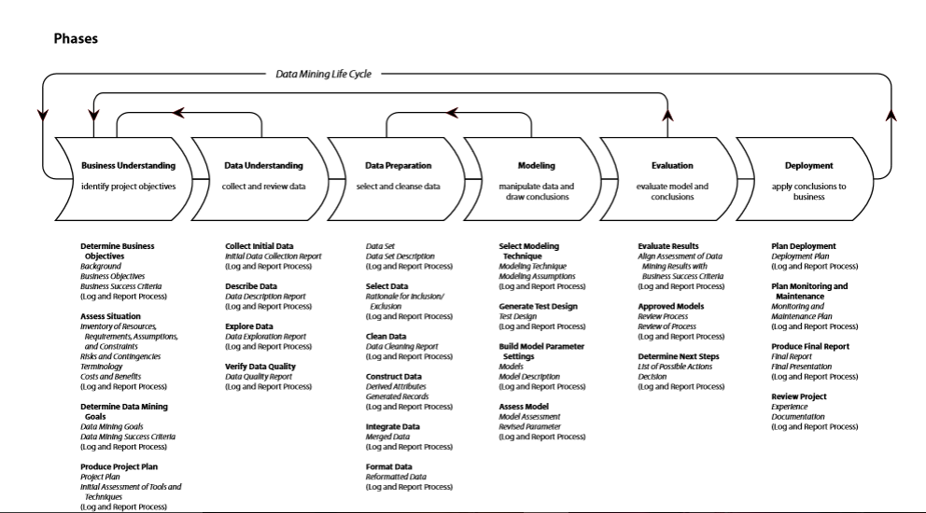
The CRISP-DM Project Methodology
Discussion Topic

Slide 12
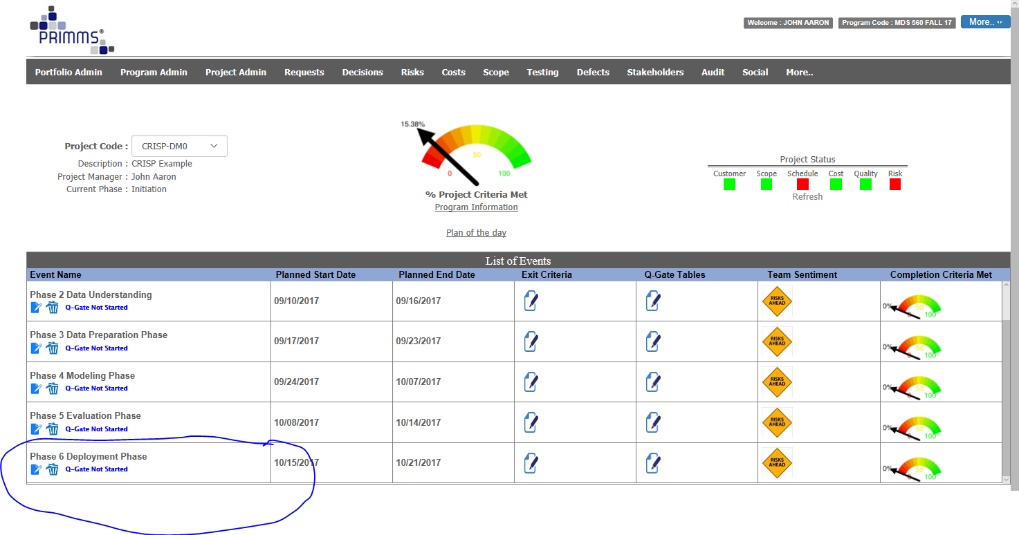

Slide 13
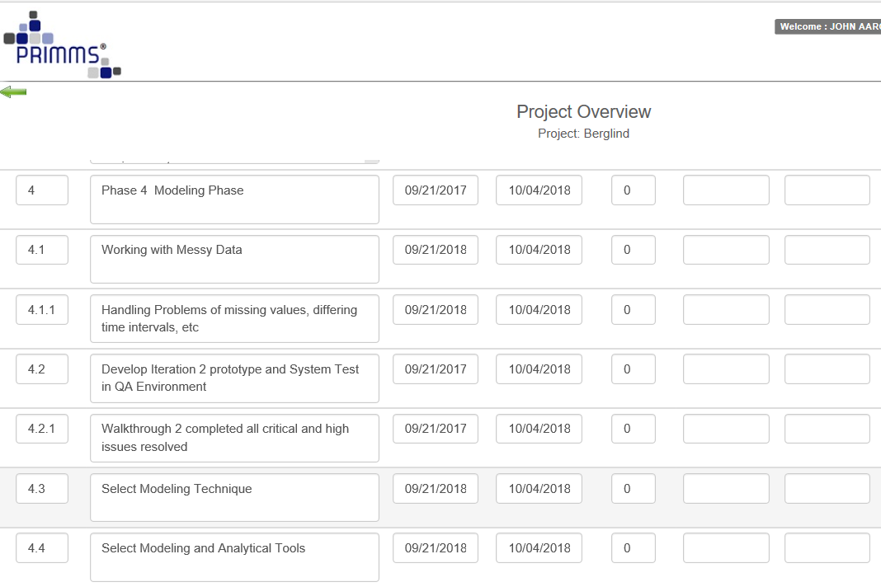

Slide 14
The CRISP-DM Project Methodology
Discussion Topic

Slide 15
The CRISP Life Cycle Is Actually Two Life Cycles
Objectives
Production
Data and Process Mining
Unit Test and UAT
Data Discovery and Algorithm Development
Machine Learning
Solution Deployment
Device
Tested
Code (Typically C, C+)

Slide 16
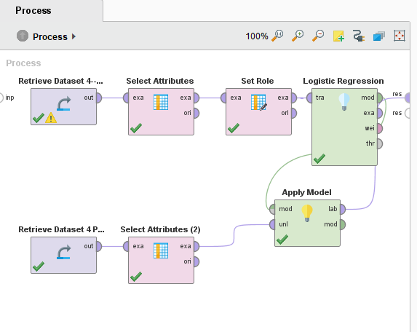
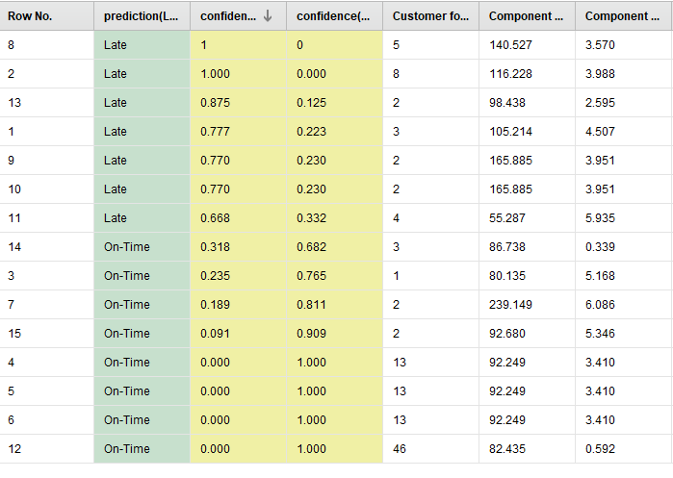
Deploying the Model to Production and Making Forecasts
Historical Data Set Used to Train, Test and Deploy
Forecast
Most Recent Production Data Set Used for Prediction and then appending dataset to tune the model.

Slide 17
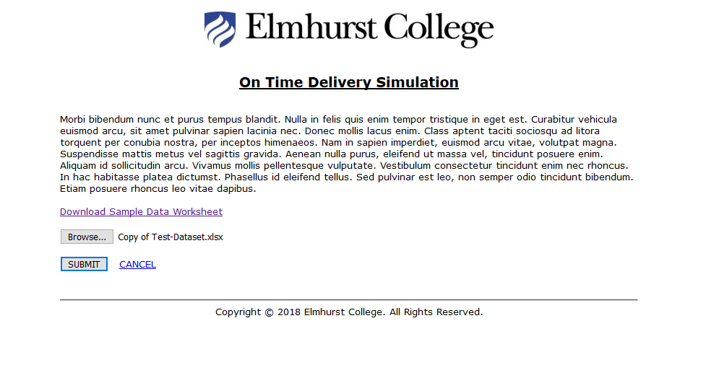
http://mds.elmhurst.edu/

Slide 18
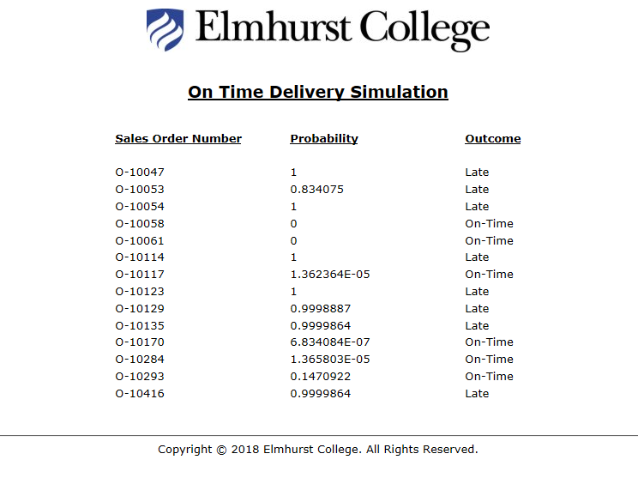

Slide 19
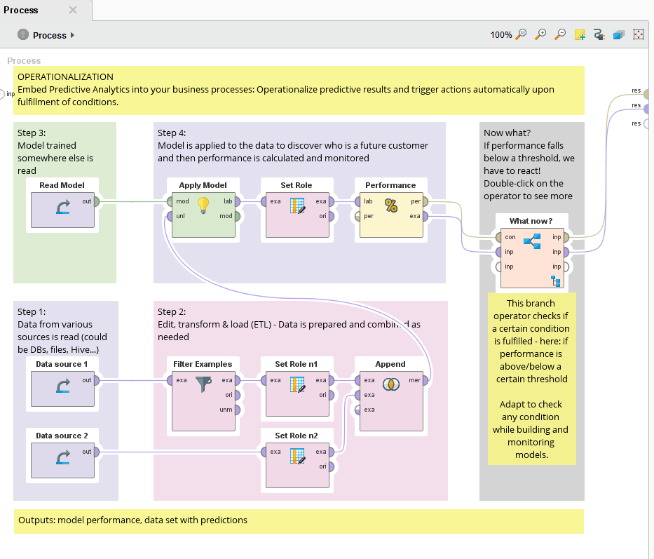
A Production Template in
Rapidminer

Slide 20
Text Analytics

Slide 21
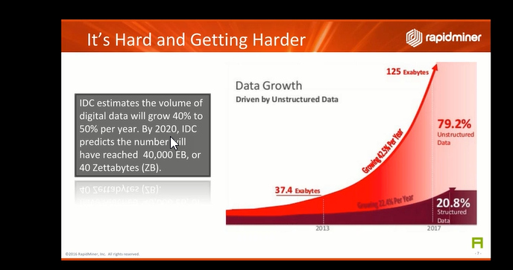
The Growth of Text (Unstructured) Data

Slide 22
Text Can Be Useful In All Functional Areas of an Enterprise
But Labels and Predictor Variables Are Not as Clear Cut
Project Performance Reporting:
Cost
Scope
Schedule
Quality
Resources
Risk
IT Performance Reporting:
Cost
Outages
System Performance
Incidents
Security
Audits
Projects
Operations Projects
IT Infrastructure & Networks
-Replacement
-Process Improvement
Operations Performance Reporting
Our next case is a customer service example….Comcast consumer complaints.

Slide 23
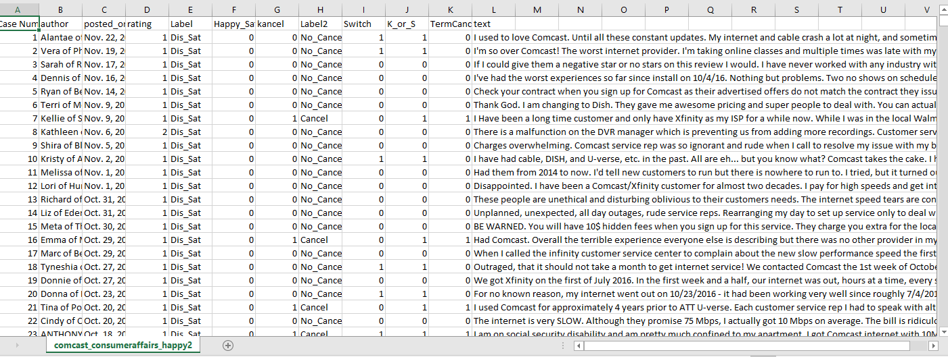
Comcast Complaints Example

Slide 24
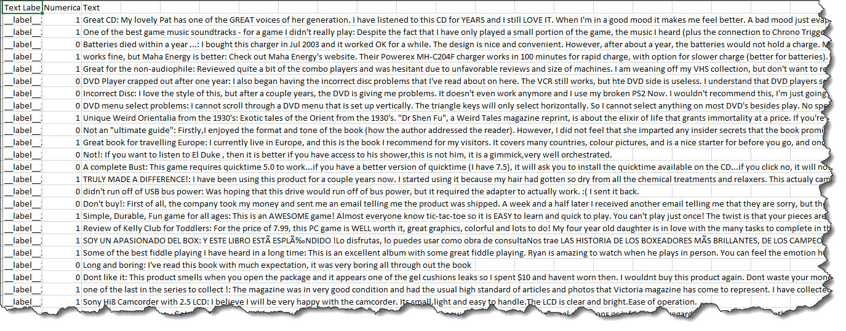
Amazon Cell Phone Product Evaluations

Slide 25
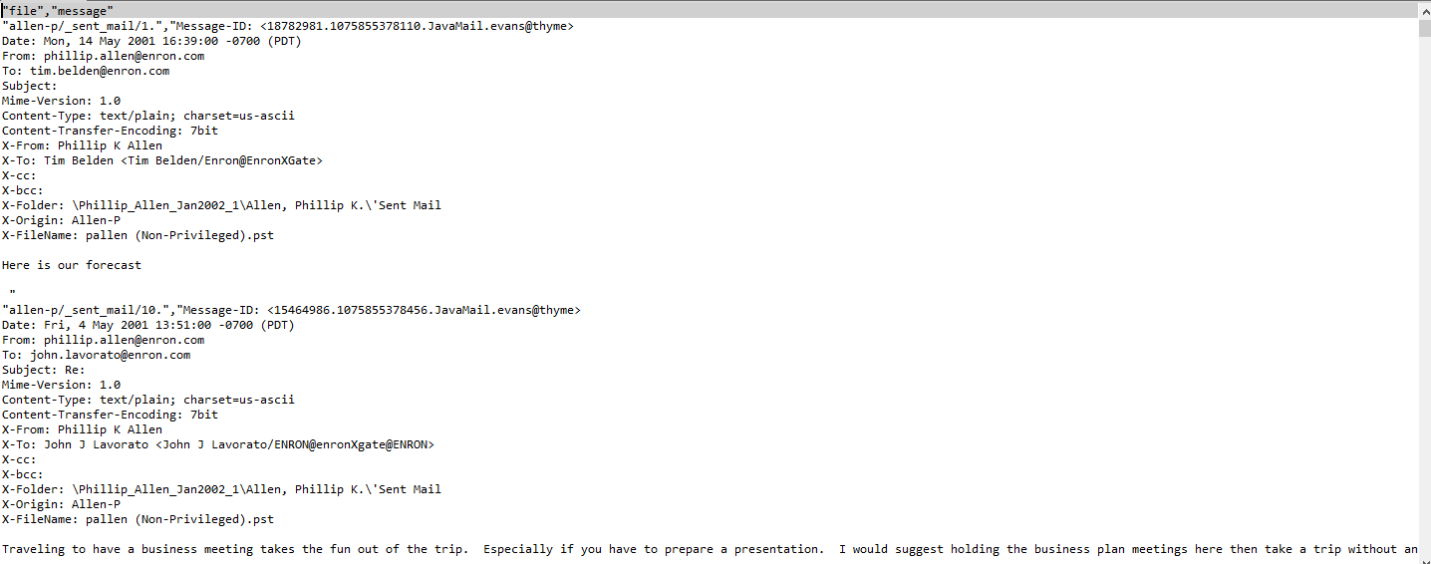
Emails—Example Enron
Big Data—Too Big for Excel

Slide 26
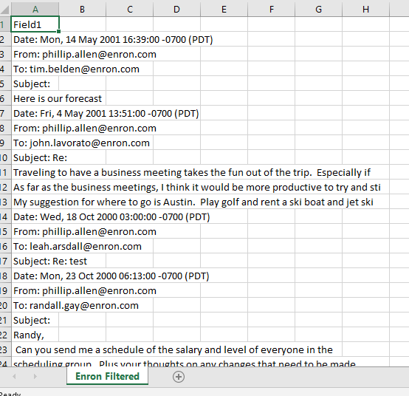
Enron Sample

Slide 27
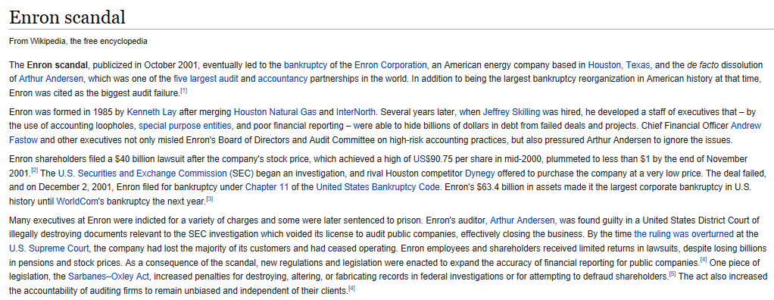
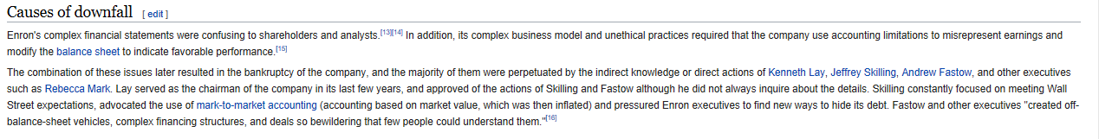

Slide 28
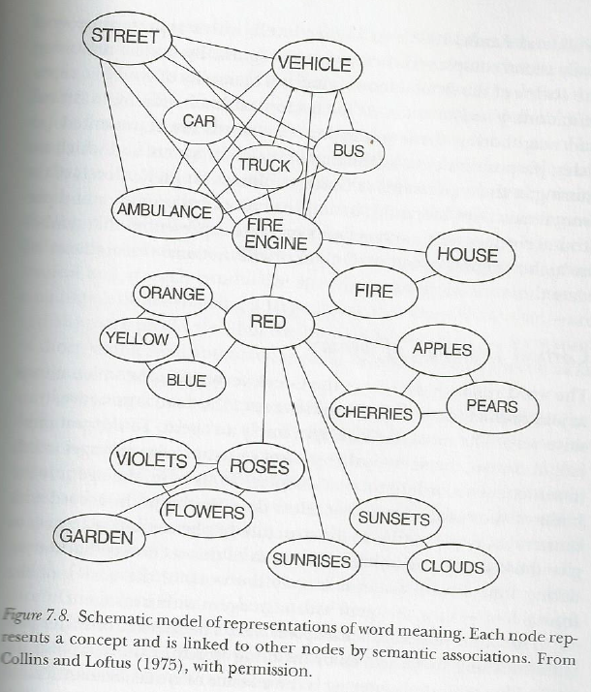
Concept linkages—A Neuroscience Perspective

Slide 29
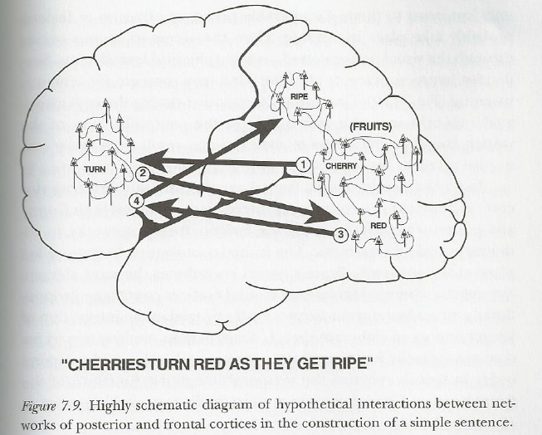

Slide 30
Identifying the Underlying Causes of Behavior—Converting Text Variables Into Strategy and Action
Example –Comcast Dataset

Slide 31
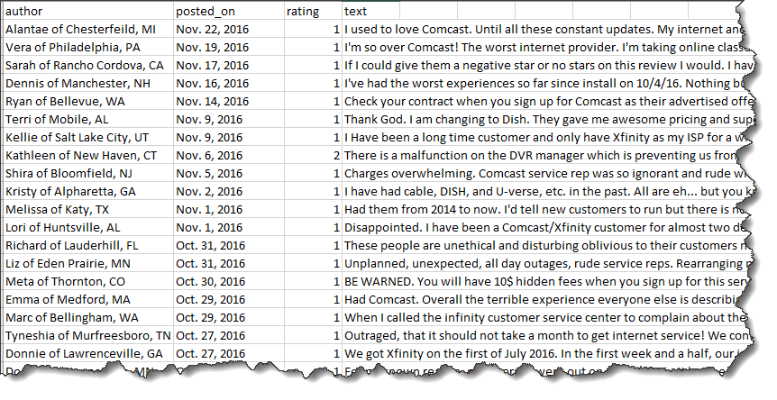
Comcast VOC Public Dataset
Available data of Comcast complaints 5600+ reduced to 4100 after remove missing and uncertain values
It consists of the following fields:
Author (first name, city and state)
Posted_on date
Rating (0 to 5)
Complaint text

Slide 32
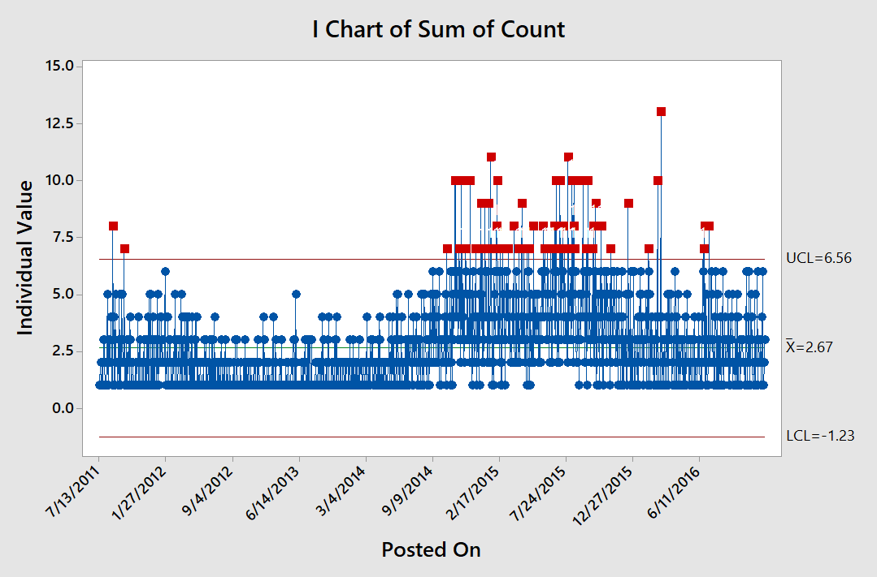
Minitab Graph:
Number of Complaint
Records Posted
Per Day in
Comcast
Dataset Grew
Throughout 2015
Period of Difficulty for the Company

Slide 33
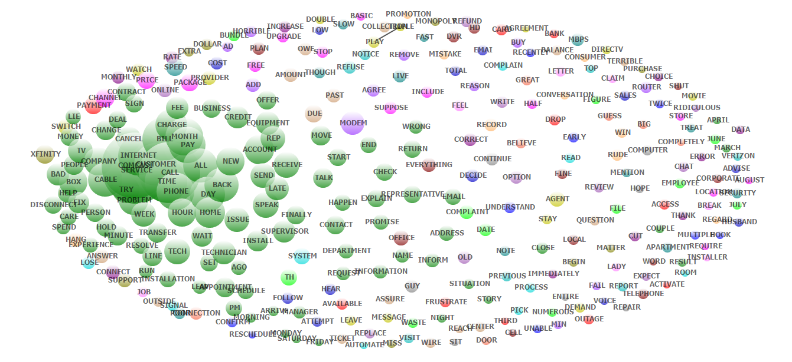
Wordstat Text Analysis Applied to Comcast Dataset
Layer #1 Overall Bag of Words and Topics –Informative But Not Yet Actionable

Slide 34
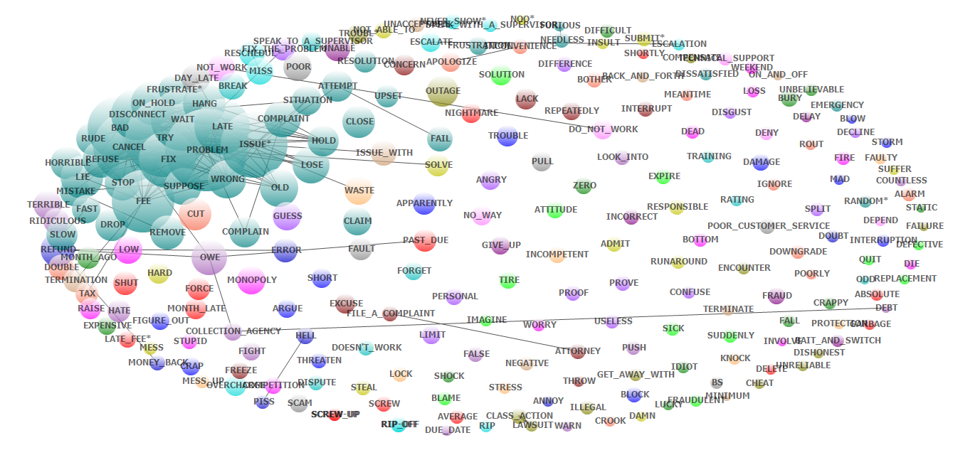
Wordstat Text Analysis Applied to Comcast Dataset —With Negative Dictionary Filter
Layer #2 Topics –Much More Revealing and More Actionable

Slide 35
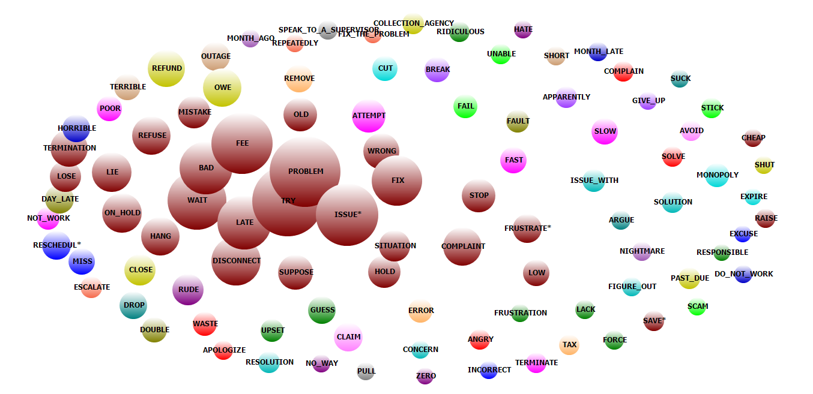
Filtered For Those Who Mentioned Cancellation

Slide 36
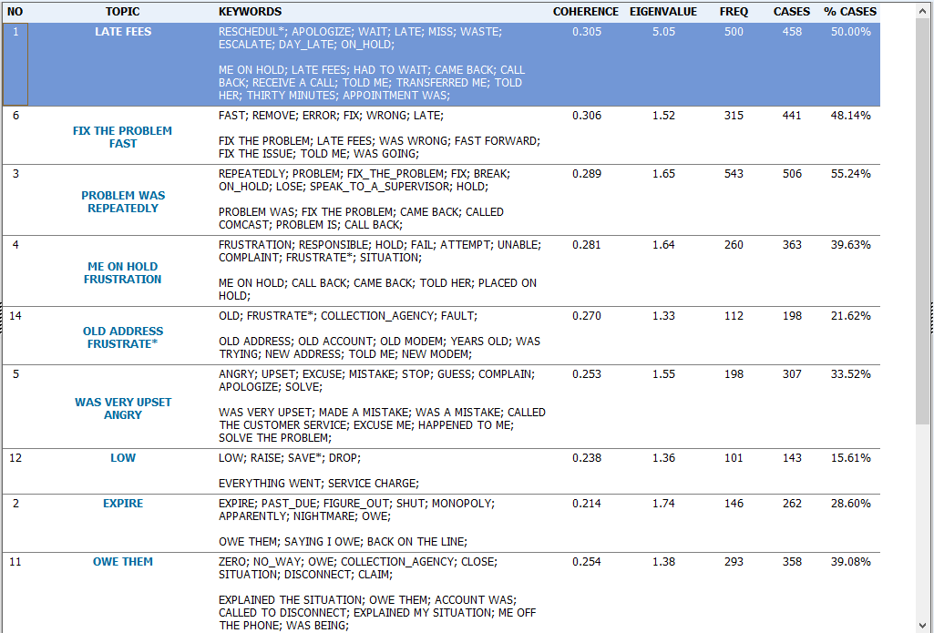

Slide 37
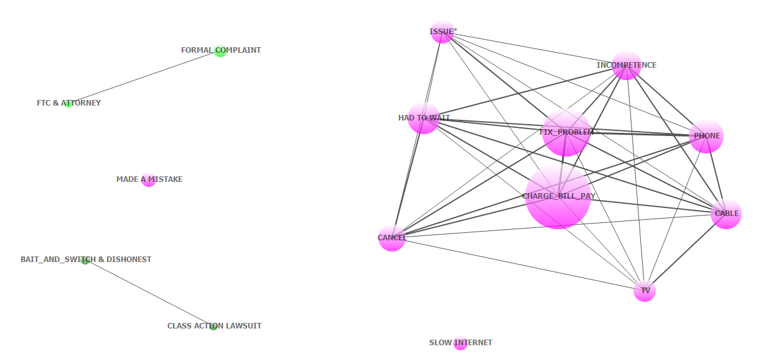
Wordstat Text Analysis Applied to Comcast Dataset—With Factor Analysis Dictionary Filter
Summarizing Layer #3—Topics and Phrases with Linkages Form Actionable Clusters
Result: The Underlying Problem was Comcast’s Inability to Resolve Emergent Phone, Cable, TV Performance Problems. These problems translated to customer billing issues that were compounded by poor customer service practices. These were the priorities for Comcast at the time. Did they have early visibility to this?

Slide 38
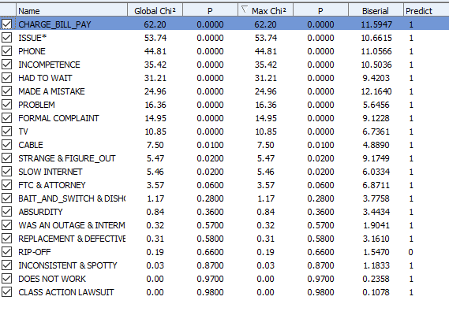
Layer 3 Summary Variable Importance Determination Using Naïve Bayes’ Classifier

Slide 39
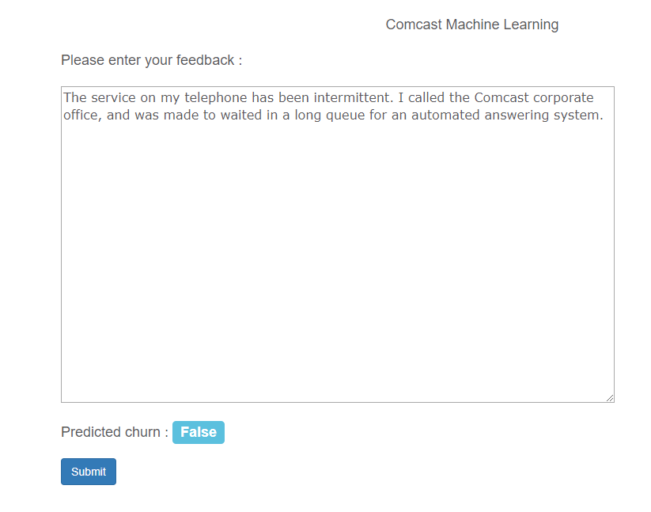
Production Prototype Based Upon Machine Learning Naïve Bayes
URL
Predicts Customer Will Not Cancel
http://projectrimms.com/ComcastML.aspx

Slide 40
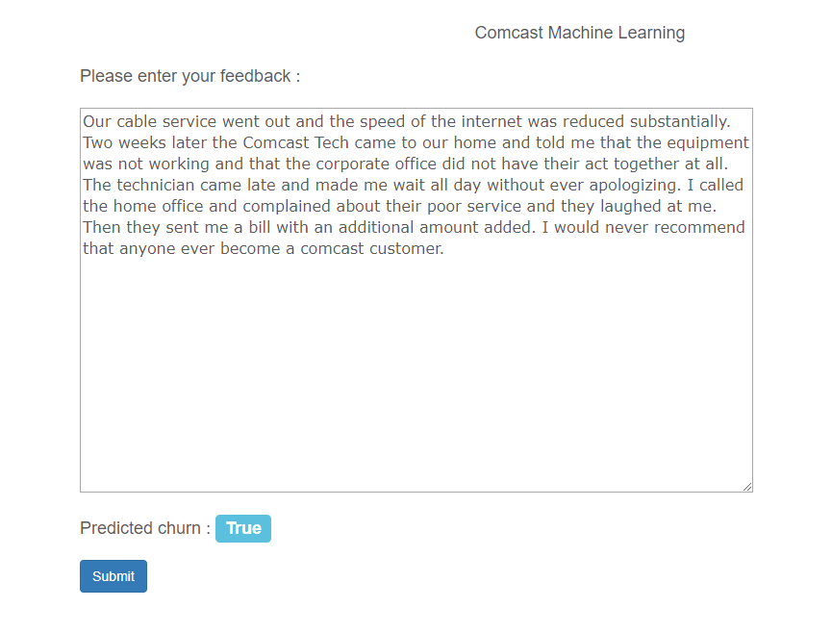
Production Prototype Based Upon Machine Learning
Predicts Customer Will Cancel

Slide 41
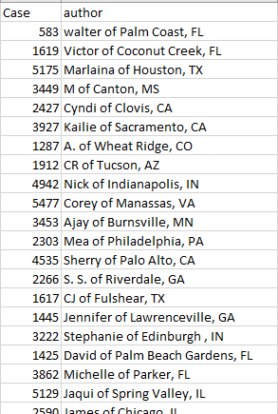
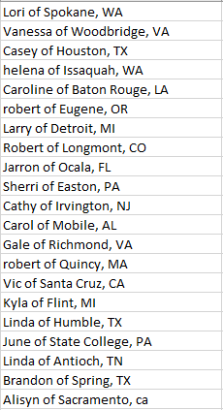
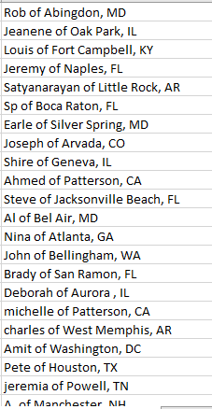
The Predictive Model Identifies Targets For a Risk Management Strategy for Comcast
Customer Nearly Certain to Cancel
Customers Highly Likely to Cancel
1,274 Probable to Cancel
To 114 total
To 52 total
To 1274 total

Slide 42
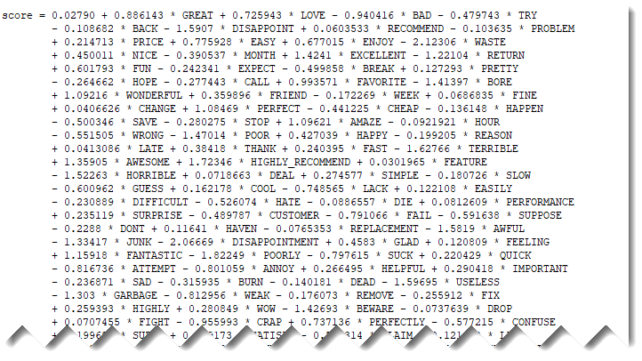
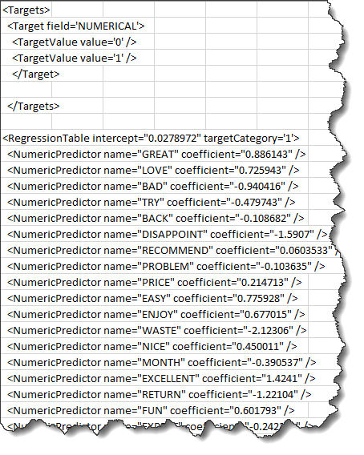
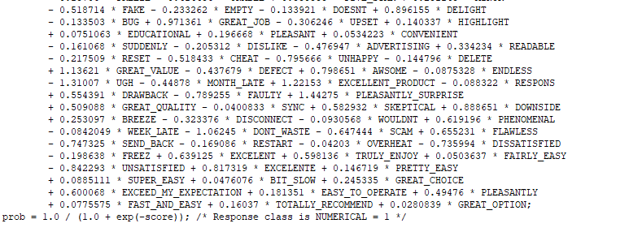
Example of Deployed Code for a Text Model

Slide 43
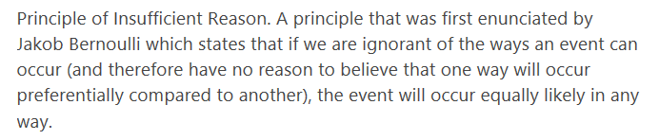
Principle of Insufficient Reason
This principle, which is very much tied to Shannon’s principle of information entropy, is a driving force of data science. Without data every possible business action (i.e. solution) is equally likely to deliver the desired outcome. If we attack a problem using all possible actions (solutions) at once, however, we can no longer be efficient and competitive. The identification of variable importance in data science models enables us to prioritize actions leading to increased efficiency and effectiveness.

Slide 44
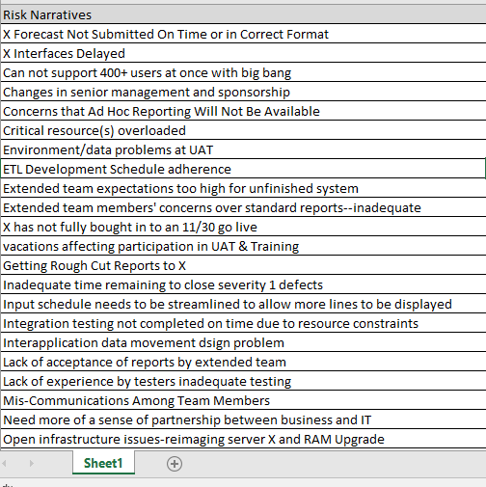
Risk Dataset is A Small Subset of the PRIMMS Example
Project
Week
Team member
Problem: How to extract useful dimensions and merge with structured data?

Slide 45
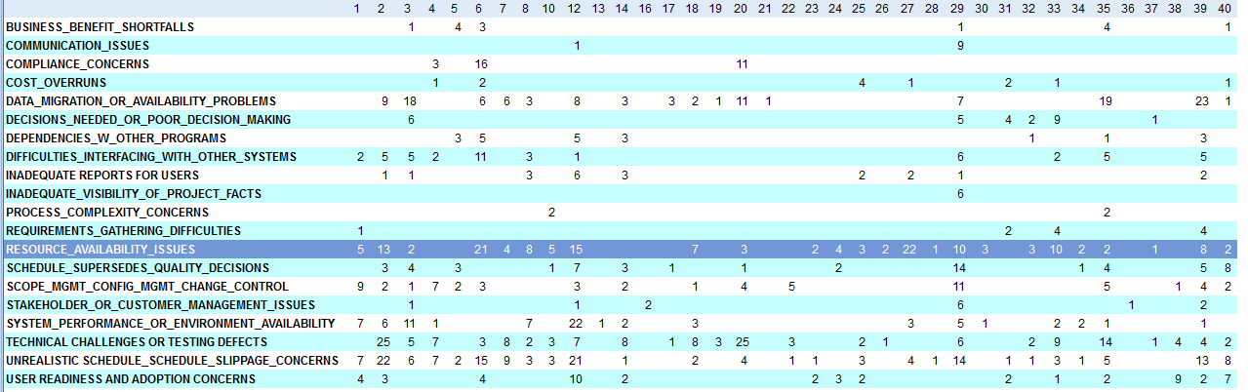
Dataset 6 Reflects Case Occurrences of Risk Categories By Specific Projects
Projects 1 through 40

Slide 46
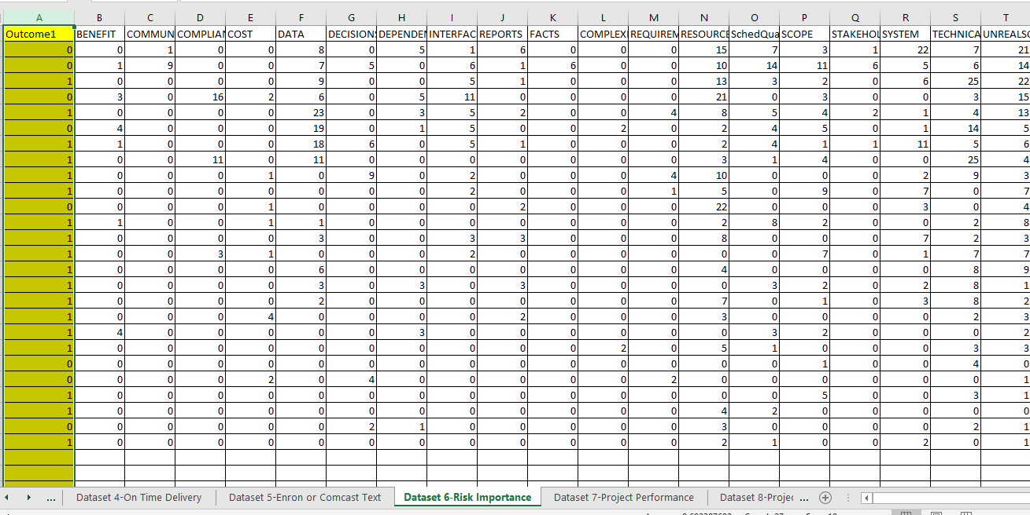
Target Label Representing Project Outcome success or Failure
(0 to 1)
Latent/Predictor Variables Based Upon Frequency of Mentions From Weekly Surveys Conducted during Projects

Slide 47
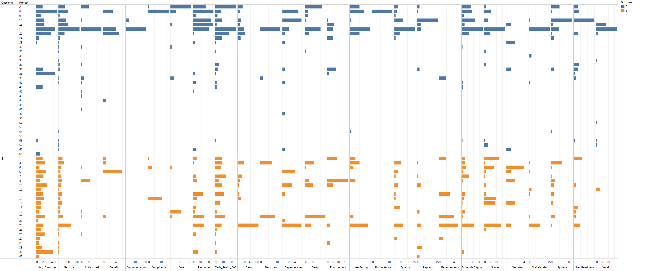
Profile of 57 Projects Studied for Which Weekly Risk Identification Methodology Was Requested
37 Projects Made it into Execution Phases
20 Project Did Not Make It Out of Initiation/Planning

Slide 48
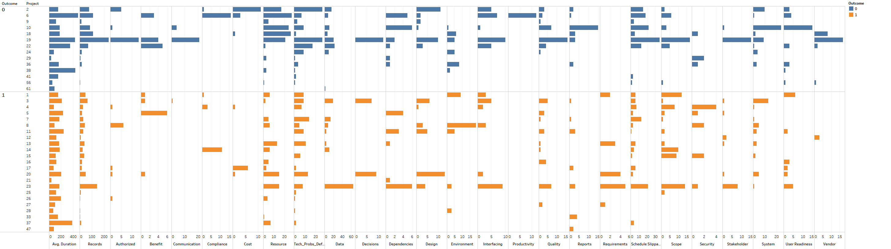
Profile of 37 Executed Projects By Risk Category Number of Mentions
Successful (Orange) and Unsuccessful (Blue)
Each Project Has Its Own “Signature”

Slide 50
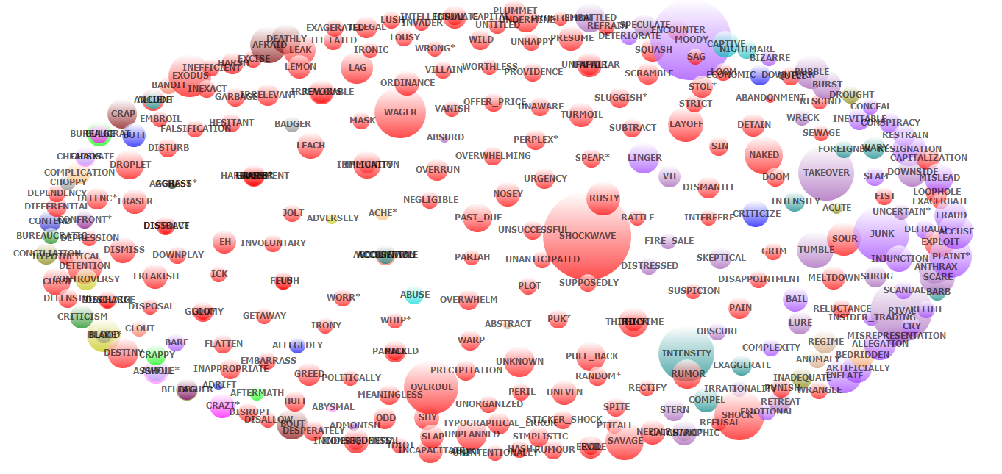
Enron—Finding Illegal Activity From Emails—Using the Threats Dictionary

Slide 51
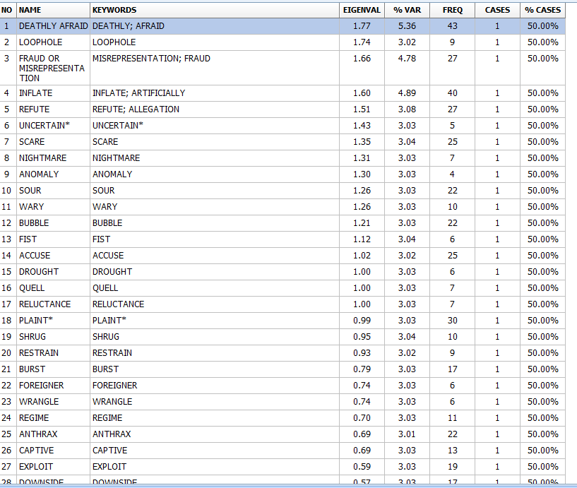
Topic Analysis of Enron

Slide 52




Slide 53
Appendix

Slide 54

Click Create New Project

Slide 55

1) Click Import
2) Click MS Excel
3) Select file from the class shared drive

Slide 56

Download to your local drive
QDA Files

Slide 57

QDA Will Execute and Give You This Screen View

Slide 58

Then Select Analyze from the Menu
And then select Content Analysis

Slide 59

Select risk Narrative
This will take you into Wordstat
Then hit OK

Slide 60

Once in Wordstat, bring in the dictionary (Reporting5) from BB shared drive and then check categorization

Slide 61

You will then receive this view

Slide 62

Then Go to Frequencies, and You Will Receive This View

Slide 63

Using the Full Dataset……………..

Slide 64
Target Label Representing Project Outcome success or Failure
(0 to 1)
Latent/Predictor Variables Based Upon Frequency of Mentions From Weekly Surveys Conducted during Projects
Your Assignment is to Model Topic Frequency to Project Outcomes
Too small for Automodel

Slide 65

Comcast Case Study of Customer Churn
Rating—nearly all rated low
“Cancel”—more important

Slide 66

Export from Wordstat and then import into Rapidminer
Segmentation of Comcast Customers Through Clustering Using Rapidminer

Slide 67

This Produces a Flat File of Structured Data That Can Now Be Analyzed Using Additional Data Science Tools

Slide 68

Next, We Perform Clustering and Then We Predict the Clusters

Slide 69

Machine Learning Gives Us Insights As to What Drives Clustering

Slide 70

This Adds a Cluster Labels to Our Dataset
Then, send this object to Turbo Prep

Slide 71

Click on Export Submenu

Slide 72

And Then Import Into Tableau (or any other analytic tool) and Analyze the Clusters For Segmentation

Slide 73

Going Back Into Rapidminer We Can Use “Cancel” as a Label and Then Predict Churn and Identify Importance Weights

Slide 74

Churn List in Descending Order of Probability
Insert Customer ID Number

Slide 75


Feature Weights For Churn

Slide 76


